Slide 1



School of Information Technology
https://www.monash.edu.my/
FIT5226
Multi-agent System & Collective Behaviour
Week 9: MiniMax Q-Learning
FIT3155-S2-2024
Prepared by: Bernd Meyer. Edited by: Fuad Noman
www.monash.edu.au
Notes:
Minimax Q-learning is an extension of traditional Q-learning designed for two-player zero-sum games. Its primary goal is to enable each player to learn optimal strategies while considering the actions of an adversary. How it links reinforcement learning (RL) to game theory:
Adapting RL to Multi-Agent Settings:
Traditional RL is typically single-agent, where the environment is stationary, and the agent learns from its own actions. Game theory, on the other hand, deals with strategic interactions between multiple agents, where each agent's decisions influence the others.
Minimax Q-learning adapts Q-learning to multi-agent settings by considering the adversary's actions and strategies, thus bringing elements of game theory into reinforcement learning.
Solving Zero-Sum Games:
Game theory's minimax principle (which says that in zero-sum games, a player should minimize the maximum possible loss) is applied to Q-learning.
The minimax update adjusts Q-values not just based on the agent’s own rewards but also considers the worst-case scenario where the opponent plays optimally. This ensures that the agent’s strategy is robust against the opponent’s actions.
Learning in Dynamic, Strategic Environments:
In game theory, strategies are used to determine actions based on the game state and other players' behaviors. In RL, policies are used to map states to actions.
Minimax Q-learning effectively learns mixed strategies by solving for the minimax policy, which is a game-theoretic solution.
This links the exploration-exploitation tradeoff in RL with strategic decision-making in adversarial games.

Slide 2
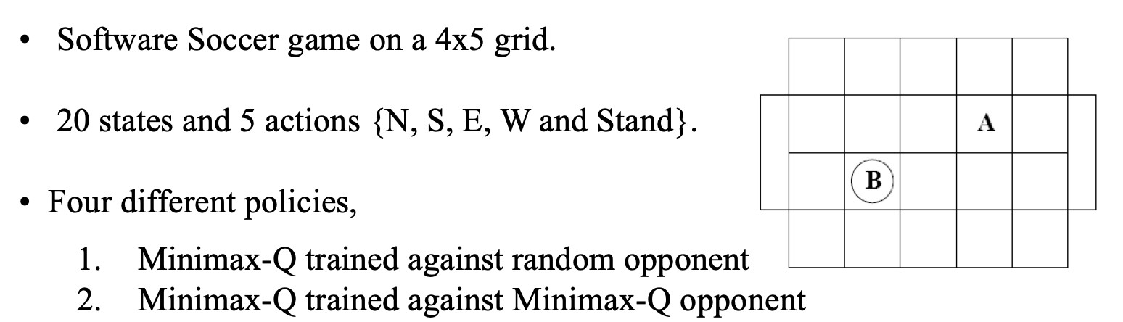
Example: Robo Soccer Game
Challenges in Multi-Agent Settings:
In a multi-agent game like Robo Soccer, both players (the attacker and the defender) act simultaneously, which introduces additional complexity:
Dynamic Environment: Each agent's next state depends not only on its own actions but also on the actions of the other agent. This means that from the perspective of one agent, the environment is non-stationary (since the other agent's actions are changing over time).
Opposing Objectives: The agents often have conflicting goals, such as one player trying to score a goal (the attacker) and the other trying to block (the defender).
FIT3155-S2-2024
Week-9
Notes:
The Robo Soccer Game can be modeled as a grid-world game where two players, an "attacker" and a "defender," are positioned on a 4x5 grid. The game involves strategic decision-making where both players choose actions from a set of five possible actions: {N (North), S (South), E (East), W (West), and stand}.
Setup
The attacker tries to move toward the defender's goal (e.g., a specific grid location) to score points.
The defender tries to block the attacker from reaching the goal by positioning itself between the attacker and the goal.
Reinforcement Learning (RL):
Q-Learning: Adapted for partially observable environments by using techniques like Deep Q-Learning with memory or recurrent networks to handle changing states.
Policy Gradient Methods: Can be used to learn policies in environments where the state space is large and changing dynamically.
Game Theory:
Dynamic Games: Incorporate the changing environment into the model by updating the game at each step based on the current state. The attacker would need to continuously adjust their strategy based on the observed or inferred position of the defender.

Slide 3
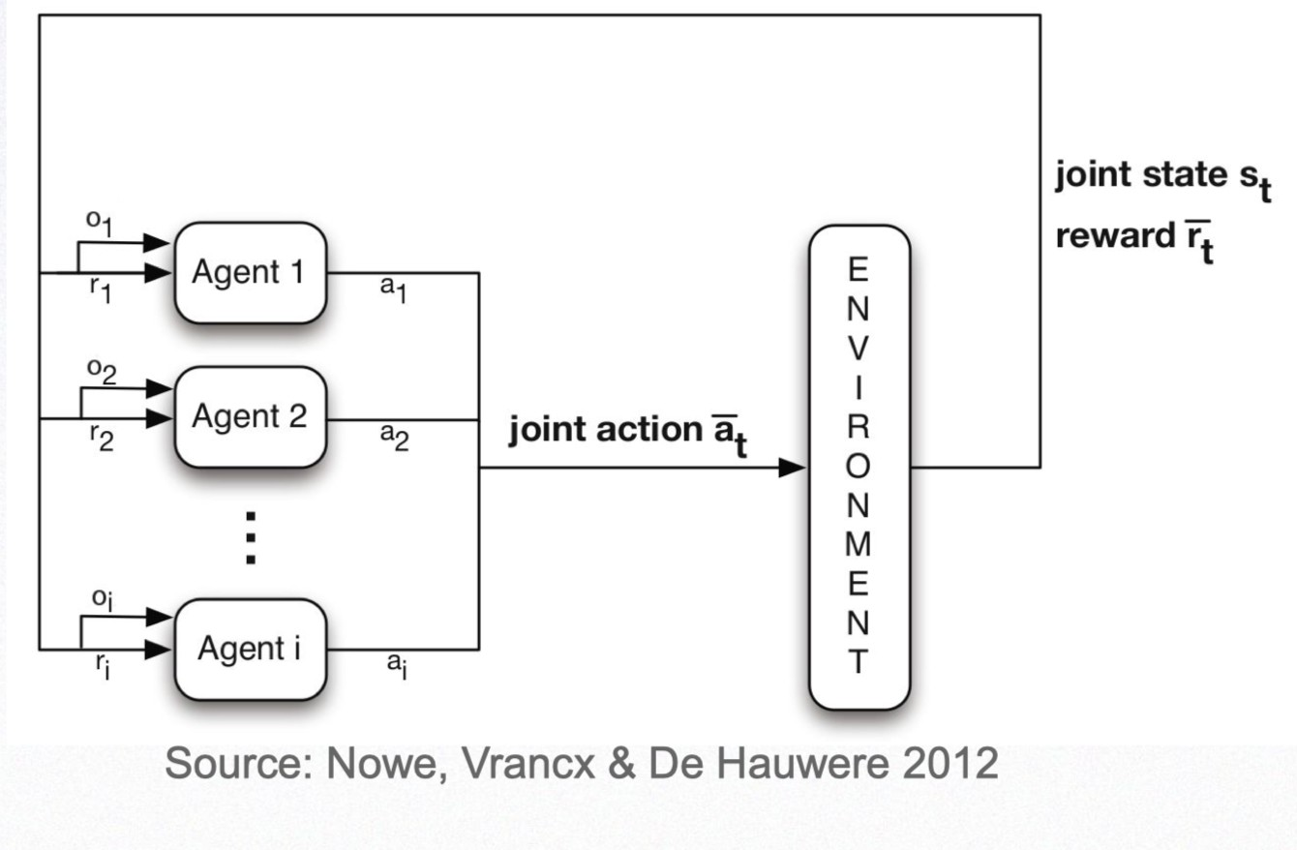
Multi-Agent-Environment Interaction
FIT3155-S2-2024
Week-9
Notes:
Minimax Q-learning is a variant of the traditional Q-learning algorithm tailored for competitive, multi-agent environments, typically modeled as zero-sum games. The goal of Minimax Q-learning is for an agent to learn an optimal strategy that maximizes its own reward while minimizing the opponent's reward. This is especially useful in adversarial games, such as chess, where one player's gain is the other player's loss.

Slide 4
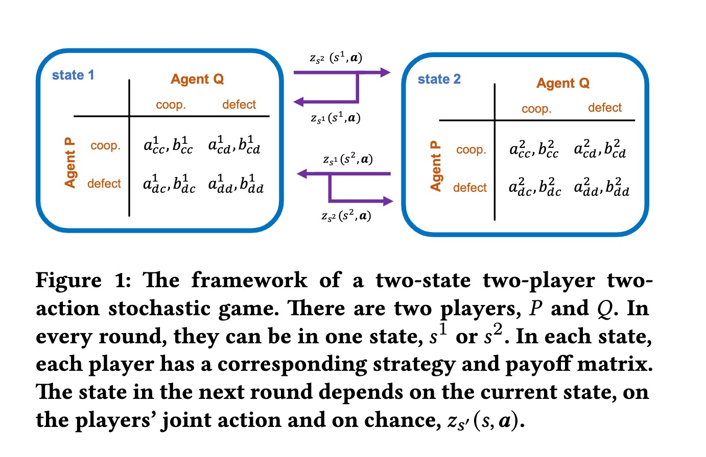
Markov Games
from C. Deng et al: Modeling Replicator Dynamics in Stochastic Games Using Markov Chain Method.AAMAS 2021
FIT3155-S2-2024
Week-9
Notes:
In the two-state, two-player, two-action stochastic game framework:
Game Overview:
Two Players (P and Q):
Each player has its own strategy and payoff matrix in each state.
Both players choose an action at each step, and their actions influence the game's outcome.
Two States (s₁ and s₂):
The game can be in one of two possible states at any given round, labeled as s₁ and s₂.
Each state has a different payoff structure for the players, meaning the strategies they choose may vary depending on the current state.
Two Actions (for Each Player):
Each player can choose from two possible actions in each state. For example, the actions could be to cooperate or defect, move left or right, etc.
Game Dynamics:
Current State and Joint Action:
The current state (either s₁ or s₂) and the players' joint actions determine what happens next.
Each player independently selects an action in the current state. Together, these actions form a joint action (a pair of actions, one from each player).
Transition to the Next State:
The next state the players find themselves in depends on the current state, the joint action of the players, and a probabilistic element (chance). This is typically modeled by a transition function T(s, a₁, a₂), which specifies the probability of transitioning from one state to another based on the joint actions a₁ and a₂ taken by players P and Q.
Strategy and Payoff Matrices:
In each state, the players use a strategy matrix to choose actions and a payoff matrix to determine their rewards.
The strategy matrix describes the probabilities of selecting different actions in a given state.
The payoff matrix provides the immediate reward each player receives based on the joint actions.
Chance (zₛ' (s, a)):
The transition to the next state isn't deterministic. Instead, there is an element of chance involved, represented as zₛ' (s, a). This represents the probability that, given state s and joint action a (the actions taken by both players), the game transitions to state s' in the next round.
Summary of Game Flow:
Current State: The game is in one of two states, s₁ or s₂.
Action Selection: Each player chooses an action from their set of two possible actions, based on their strategy and the current state.
Payoffs: After the actions are selected, the players receive their payoffs according to the payoff matrix associated with the current state and actions.
State Transition: The game then transitions to a new state (either stays in the same state or moves to the other one), determined by the current state, the joint action of the players, and chance.
Repeat: The game continues, repeating this process, with players choosing actions based on the current state and strategies, receiving payoffs, and transitioning between states.
This framework can be used to model various strategic interactions between two players, with the stochastic element (chance) influencing the dynamics of the game. The goal for each player is typically to maximize their long-term payoff, taking into account the strategies of the other player and the probabilistic transitions between states.

Slide 5
Example of a Markov Game
FIT3155-S2-2024
Week-9
Notes:
The Robo Soccer Game can be modeled as a grid-world game where two players, an "attacker" and a "defender," are positioned on a 4x5 grid. The game involves strategic decision-making where both players choose actions from a set of five possible actions: {N (North), S (South), E (East), W (West), and stand}.
Setup
The attacker tries to move toward the defender's goal (e.g., a specific grid location) to score points.
The defender tries to block the attacker from reaching the goal by positioning itself between the attacker and the goal.
Reinforcement Learning (RL):
Q-Learning: Adapted for partially observable environments by using techniques like Deep Q-Learning with memory or recurrent networks to handle changing states.
Policy Gradient Methods: Can be used to learn policies in environments where the state space is large and changing dynamically.
Game Theory:
Dynamic Games: Incorporate the changing environment into the model by updating the game at each step based on the current state. The attacker would need to continuously adjust their strategy based on the observed or inferred position of the defender.

Slide 6
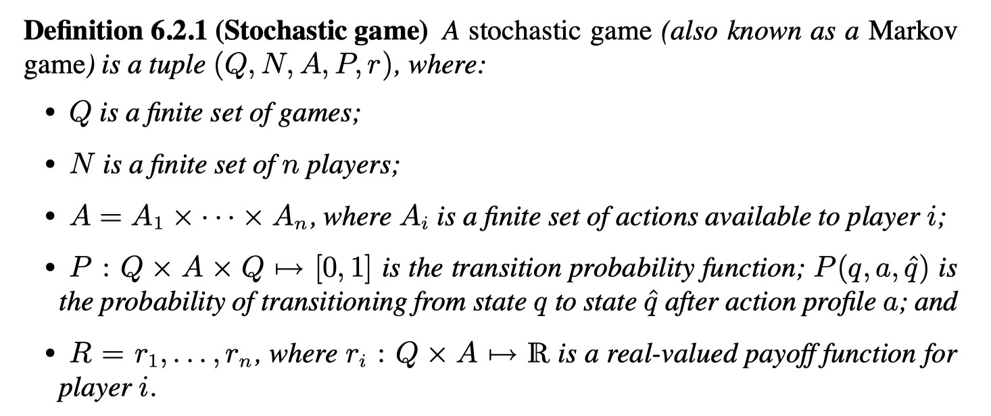
Markov Game: Definition
FIT3155-S2-2024
Week-9
Notes:
How Minimax Q-learning Works:
In a traditional Q-learning setting, an agent learns the value of state-action pairs (Q(s, a)) to maximize its expected cumulative reward. However, in a zero-sum game, the agent's reward depends on both its own actions and the opponent's actions. Minimax Q-learning modifies the value update mechanism to account for the worst-case scenario, assuming that the opponent is playing optimally to minimize the agent's reward.
Key Components:
State s: Represents the current situation of the game or environment.
Action a: The action taken by the agent.
Opponent's Action b: The action taken by the opponent, often represented as a "maximization" problem for the opponent.
Q-values: Instead of a standard Q-value update, the agent computes the minimax value of the state, which is the worst-case expected reward assuming the opponent chooses the action that minimizes the agent's reward.
The agent learns the optimal policy by choosing actions that maximize the minimax value of the Q-function:
$$Q\left(s,a\right)←\left(1−α\right)Q\left(s,a\right)+α\left(r+γ⋅\min_{b}{\max_{a^{′}}{Q\left(s^{′},a^{′}\right)}}\right)$$
$α$: Learning rate
γ: Discount factor
r: Immediate reward
$\min_{b}$: Represents the opponent's optimal strategy (minimizing agent’s reward).
$\max_{a′}$: Represents the agent’s best response to the opponent's strategy.

Slide 7
Nash in Markov Games
Theorem:
Every two-player, general-sum, average reward, irreducible stochastic game has a Nash equilibrium
“irreducible” means here that the Markov Chain of games must be irreducible, in other words, every game must always remain reachable, regardless of which strategies are played.
FIT3155-S2-2024
Week-9
Notes:
The theorem can be interpreted in the context of stochastic games, which generalize repeated games to dynamic environments where players' actions not only determine their immediate payoffs but also influence the state of the game in the future. Here's a breakdown of the key elements of the theorem:
Theorem:
Every two-player, general-sum, average reward, irreducible stochastic game has a Nash equilibrium.
Key Components:
Two-player: The game involves two participants (players), who make decisions based on their strategies.
General-sum: The players' payoffs are not necessarily oppositional as in zero-sum games. The sum of the payoffs can vary depending on the strategies chosen by the players, allowing for potential cooperation or competition.
Average reward: The goal of each player is to maximize their long-term average reward (also known as the expected average reward per step). Unlike finite games or discounted-reward settings, the focus is on the sustained performance over time rather than immediate payoffs or rewards that diminish over time.
Irreducible stochastic game:
Stochastic game: The game is dynamic, meaning it evolves across different states. In each state, players choose actions, which determine both their rewards and the next state of the game, according to some probability distribution.
Irreducible: This means that the Markov Chain representing the state transitions of the game is irreducible. In other words, starting from any state, it's always possible to reach any other state (though not necessarily in one step). This ensures that the game does not get "stuck" in any subset of states and that all parts of the game are eventually accessible, regardless of the strategies employed by the players.
Nash equilibrium: A Nash equilibrium is a set of strategies (one for each player) where no player can unilaterally improve their average reward by deviating from their strategy, given that the other player sticks to theirs.
What the theorem says:
In an irreducible, stochastic game with two players, the players will always have a Nash equilibrium strategy. This means that there exists a strategy pair (one for each player) such that neither player has an incentive to change their strategy, assuming the other player doesn’t change theirs. The fact that the game is irreducible ensures that all states of the game are accessible, which is critical for ensuring that long-term equilibria exist under the average reward criterion.
Importance of Irreducibility:
Irreducibility guarantees that no matter what strategies the players choose, every part of the game's state space remains reachable. Without this condition, it's possible that certain strategies could effectively "trap" the game in a subset of states, potentially undermining the existence of a well-defined long-term average reward or equilibrium strategy.
Implications:
The theorem is significant because it ensures that even in complex dynamic environments where players' actions affect both their immediate rewards and the future states of the game, there will always be at least one stable pair of strategies (a Nash equilibrium) that satisfies the average reward criterion. This provides a strong theoretical foundation for analyzing long-term strategic behavior in dynamic settings.
The existence of a Nash equilibrium in such games is foundational for the study of multi-agent systems, economic models, and game-theoretic applications in artificial intelligence, where decisions made by agents today affect the future dynamics of the environment.

Slide 8
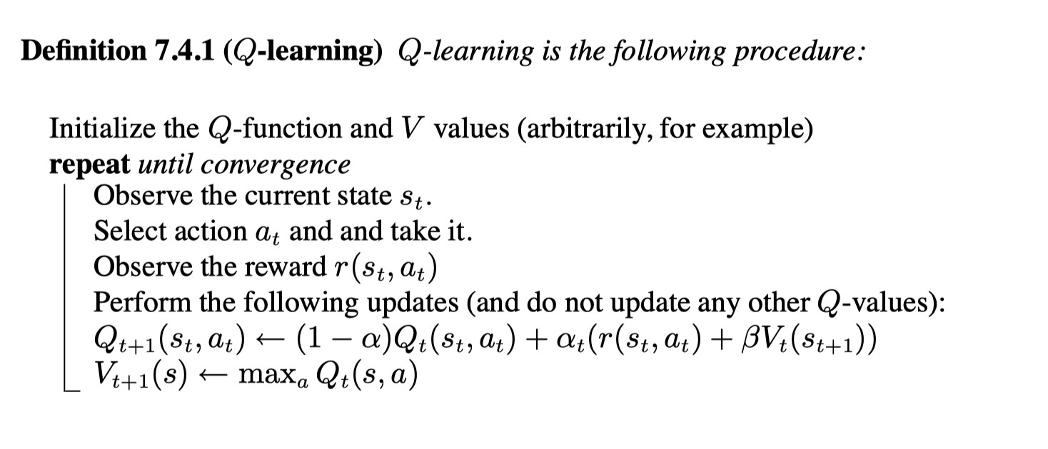
Standard Q-Learning
Recall standard Q-Learning (here in the formulation from SLB).
This can be adapted to 2-player zero-sum games relatively immediately.
FIT3155-S2-2024
Week-9
Notes:
This is the Q-learning we saw earlier in RL part. It was applicable for single-agent game. We only have one player with one action at each step.

Slide 9
Q-value derivation for known joint action
a_{t} is the player’s own action, o_{t} that of the opponent.
Nothing has changed except for switching from a single agent’s action to the joint action.This means that the player needs to know the other player’s action to perform MiniMax-Q.
Note that this is different from Replicator dynamics and/or Cross Learning (but these are stateless)
FIT3155-S2-2024
Week-9
Notes:
The equation represents the update rule for the Q-value of an agent i in a multi-agent environment, where the agent is learning to act in a stochastic setting. Here's a breakdown of the terms and a step-by-step derivation:
Terms:
$Q_{i,t}\left(s_{t}, a_{t}, o_{t}\right)$: The Q-value at time step $t$ for agent $i$, representing the expected utility (reward) of taking joint action $a_{t​}$ in state $s_{t}$​, given observation $o_{t}$​.
$α_{t}$​: The learning rate at time step $t$, controlling how much the agent's new experience influences the updated Q-value.
$r_{i}\left(s_{t}, a_{t}, o_{t}\right)$: The immediate reward received by agent $i$ at time $t$ after taking joint action $a_{t​}$ in state $s_{t}$​, given observation $o_{t}$​
$β$: The discount factor, determining how much future rewards influence the current decision.
$V_{t}(s_{t+1})$: The value function at state $s_{t+1}$​, representing the expected future reward starting from state $s_{t+1}$​.
$\left(1 − α_{t}\right)$: The factor representing how much of the old Q-value is retained after updating.
Update Rule Interpretation:
The equation can be written as:
$$Q_{i,t+1}(s_{t}, a_{t}, o_{t}) = \left(1 −α_{t}\right)Q_{i,t}(s_{t}, a_{t}, o_{t}) +α_{t}\left( r_{i}\left(s_{t}, a_{t}, o_{t}\right)+β V_{t}\left(s_{t+1}\right)\right)$$
Old Q-value weighting: The term $\left(1 −α_{t}\right)Q_{i,t}(s_{t}, a_{t}, o_{t})$keeps a fraction of the old Q-value (how much depends on $α_{t}$​). This prevents the new experience from completely overriding the old Q-value.
New experience weighting: The term $α_{t}\left( r_{i}\left(s_{t}, a_{t}, o_{t}\right)+β V_{t}\left(s_{t+1}\right)\right)$ incorporates the new experience, where the agent observes the reward $r_{i}$ and the future expected reward $V_{t}\left(s_{t+1}\right)$ discounted by $β$. The learning rate $α_{t}$​​ controls how much this new experience updates the Q-value.
Derivation:
The Q-value update rule is derived from the Bellman equation for reinforcement learning. The idea is to recursively estimate the Q-value based on new information at each step. Specifically:
$$Q_{i,t}\left(s_{t}, a_{t}, o_{t}\right)=𝔼\left[ r_{i}\left(s_{t}, a_{t}, o_{t}\right)+β V_{t}\left(s_{t+1}\right)\right]$$
This means the Q-value is an estimate of the expected reward after taking action $a_{t}$ in state $s_{t}$, considering both the immediate reward and the future expected rewards.
The update rule combines:
Old estimate: The previous Q-value $Q_{i,t}\left(s_{t}, a_{t}, o_{t}\right)$
New information: The immediate reward $r_{i}\left(s_{t}, a_{t}, o_{t}\right)$ and the future reward estimate $V_{t}\left(s_{t+1}\right)$.
To update the Q-value, we use a weighted average between the old Q-value and the new estimate of the total expected reward:
$$Q_{i,t+1}(s_{t}, a_{t}, o_{t}) = \left(1 −α_{t}\right)Q_{i,t}(s_{t}, a_{t}, o_{t}) +α_{t}\left( r_{i}\left(s_{t}, a_{t}, o_{t}\right)+β V_{t}\left(s_{t+1}\right)\right)$$
This is a standard form of Q-learning or temporal difference learning used in both single-agent and multi-agent settings. In multi-agent systems, the joint action $a_{t}$ may include the actions of other agents, but the structure of the update remains similar.

Slide 10
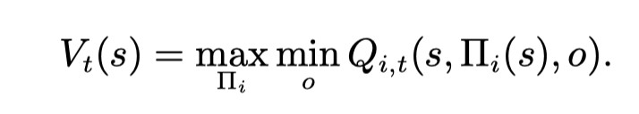
State value update according to MiniMax
The core of the method is to calculate the value according to the standard MiniMax method for 2-player zero-sum games.
In practice, this requires the use of a linear solver within the Q-iteration.
FIT3155-S2-2024
Week-9
Notes:
In MiniMax Q-learning for two-player zero-sum games, the value update for state $s$ follows a MiniMax approach, reflecting the adversarial nature of such games. Here's how the update works:
Value Update Rule:
$$V_{t}\left(s\right)=\max_{Π_{i} }\min_{o} Q_{i,t}(s, Π_{i}(s), o)$$
Where:
$V_{t}\left(s\right)$: The value of the state $s$ at time $t$, representing the maximum value that player $i$ (the row player) can guarantee, considering the worst possible response from player $o$ (the column player).
$Π_{i}\left(s\right)$: Player $i$'s policy, which defines the action $Π_{i}\left(s\right)$ that player $i$ will take in state $s$.
$Q_{i,t}(s, Π_{i}(s), o)$: The Q-value of the joint action, representing the expected reward when player $i$ chooses action $Π_{i}\left(s\right)$and the opponent $o$ responds with their action.
MiniMax Explanation:
Maximization: Player $i$ (the maximizer) tries to choose the policy $Π_{i}$ that maximizes their minimum possible payoff.
Minimization: Player $o$ (the opponent, or minimizer) tries to minimize player $i$'s payoff, acting in an adversarial manner.
Thus, the goal for player $i$ is to maximize their guaranteed reward, taking into account that their opponent $o$ will act optimally to minimize their payoff.
MiniMax in Practice:
Linear Solver: In practice, computing this update requires solving a linear programming problem at each step. The linear solver is used to find the MiniMax solution by solving for the mixed strategies (probability distributions over actions) that player iii and the opponent $o$ will use to optimize their strategies.
Q-iteration: The algorithm iteratively updates the Q-values and state values over time. At each step $t$, the algorithm computes $V_{t}\left(s\right)$ using the MiniMax formulation, then updates the Q-values based on new information from the game environment.
Summary of the Process:
At each state $s$, player $i$ looks for the best policy $Π_{i}\left(s\right)$, knowing that the opponent will respond with the action that minimizes their payoff.
The value $V_{t}\left(s\right)$ is then the maximum value that player iii can secure, considering the worst-case scenario (i.e., the opponent's best minimizing action).
This iterative process continues, using a linear solver to compute the MiniMax solution at each step, eventually converging to the optimal strategies for both players.
This method is well-suited for two-player zero-sum games where each player has opposing objectives, and it leads to finding Nash equilibria in the game.

Slide 11
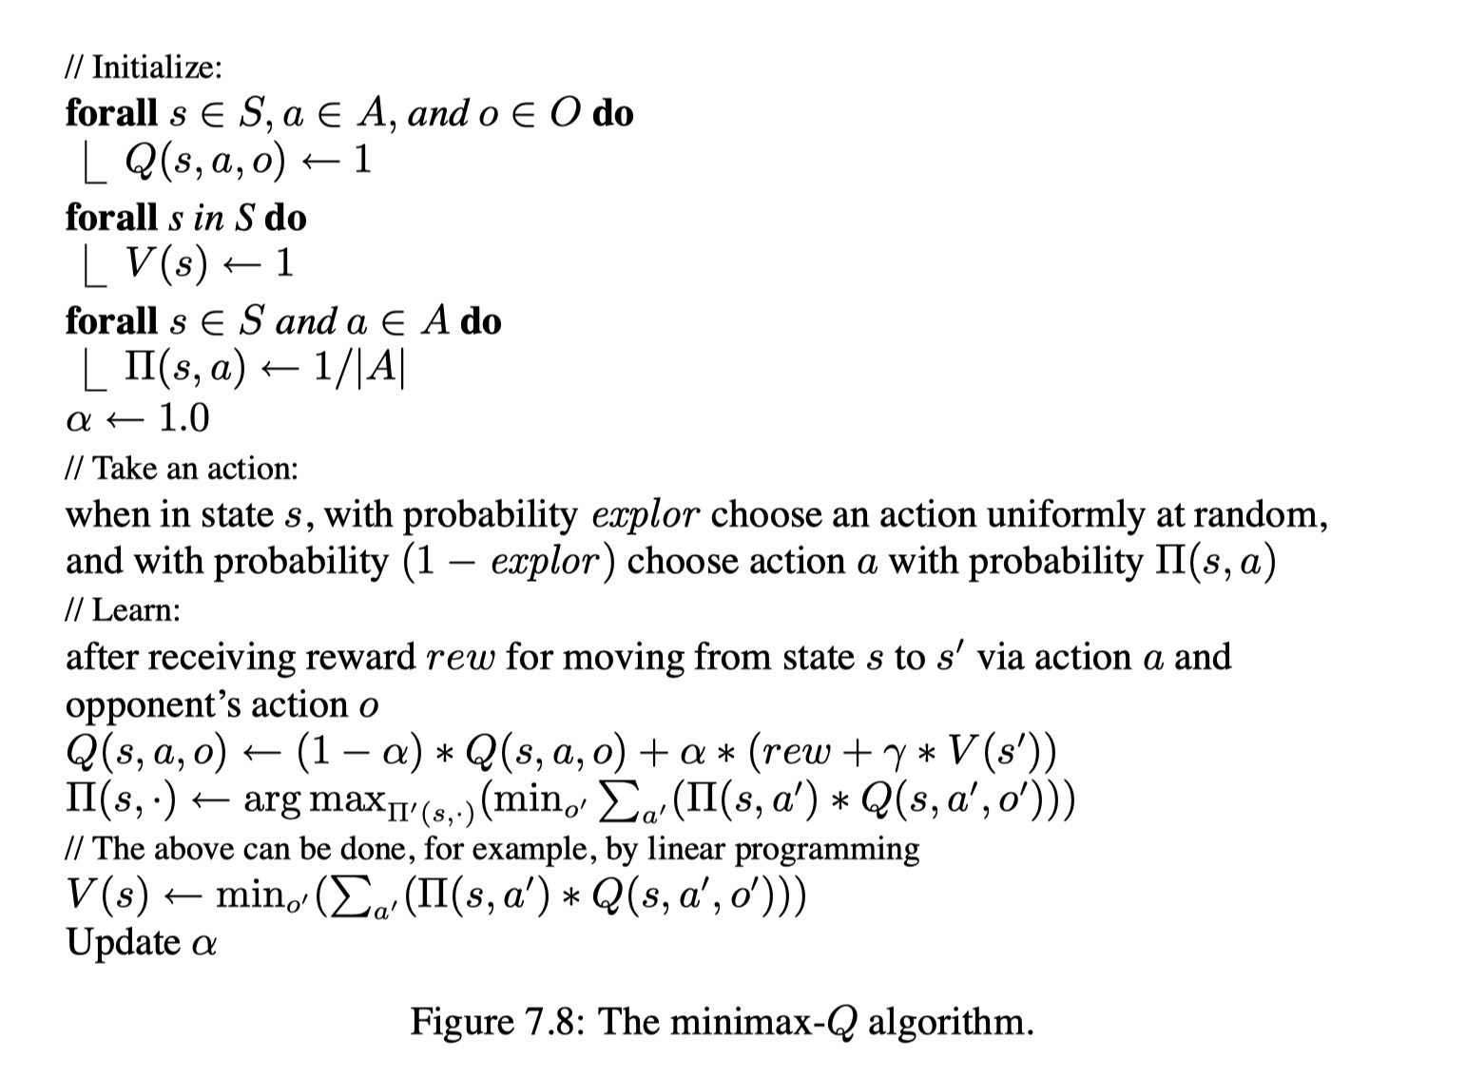
The MiniMax-Q algorithm
 | Initialization
 | Action Selection
 | Learning
 | Updating
FIT3155-S2-2024
Week-9
Notes:
Initialization:
Step 1: For every state s in the state space S, every action a in the action space A, and every opponent action o in the opponent's action space O, initialize the Q-values Q(s, a, o) to a default value (often 0).
Action Selection:
Step 2: When the agent is in a given state s, it chooses an action using an exploration-exploitation strategy:
With probability explor (exploration rate), the agent selects an action randomly from all possible actions.
With probability (1 - explor) (exploitation), the agent chooses an action a based on the learned policy Π(s, a), which is computed from the Q-values.
Learning and Updating:
Step 3: After taking action a, observing the opponent's action o, and transitioning from state s to state s', the agent receives a reward rew. The agent updates the Q-value for the state-action pair (s, a, o) using the following equation:
Q(s, a, o) ← (1 - α) * Q(s, a, o) + α * (rew + γ * V(s'))
α is the learning rate.
γ is the discount factor for future rewards.
V(s') is the value of the next state s' after the action a and opponent's action o.
Step 4: The agent then updates its policy Π(s) by solving for the MiniMax value. This can be done through linear programming:
The policy Π(s) is updated by finding the action a' that maximizes the agent’s expected Q-value considering the opponent’s strategy.
In other words, the agent tries to maximize the worst-case scenario (i.e., minimize the maximum loss) by solving a MiniMax problem.
The MiniMax computation involves:
Maximizing over the agent's actions a'.
Minimizing over the opponent's actions o.
Final Update:
Step 5: The agent updates its value estimate for state s after computing the new Q-values and policies.
Summary of Key Concepts:
Q(s, a, o): Represents the expected utility of taking action a in state s when the opponent chooses action o.
Exploration vs. Exploitation: The agent balances exploring new actions and exploiting known good actions using an exploration rate explor.
Linear Programming for MiniMax: To update the policy, the agent solves a MiniMax optimization problem that ensures it prepares for the worst-case opponent action.
Learning Process: The agent iteratively updates Q-values and policies as it interacts with the environment and opponent.

Slide 12
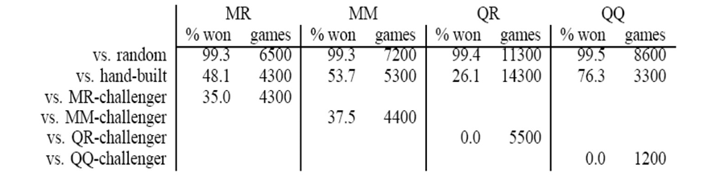
Example: Grid Soccer Defense
Game Setup:
2-player soccer
4 x 5 grid
5 actions (N, S, E, stop)
Four policies (trained):
MiniMax-Q trained against random opponent (MR)
MiniMax-Q trained against MiniMax-Q opponent (MM)
Q trained against random opponent (QR)
Q trained against Q opponent (QQ)
FIT3155-S2-2024
Week-9
Notes:
The table provides performance results for four different policies trained using various reinforcement learning (RL) and game-theoretic approaches. Game Setup:
Grid: 4x5 cells, a small soccer field where two players move to achieve their respective goals.
Players:
Attacker (A): The goal is to get past the defender and score.
Defender (D): The goal is to stop the attacker from scoring.
Actions: Each player can move North, South, East, West, or Stop (remain still). There are 5 actions in total.
Training Objective: The attacker learns policies to outmaneuver the defender, while the defender learns to optimally block the attacker.
Key Observations:
Against Random Opponents:
All policies perform very well, with win rates around 99%. Since random opponents move unpredictably, both MiniMax-Q and Q-learning policies can easily exploit their mistakes and win most games.
Against Hand-built Opponents:
MiniMax-Q trained policies (MR, MM, and QQ) perform better against hand-built opponents than Q-learning policies (QR and QQ).
The MM policy (trained against another MiniMax-Q agent) performs better that QR and MR, with a 53.7% win rate.
The QQ policy, surprisingly, performs the best, with a 76.3% win rate, potentially indicating that Q-learning models are more effective in handling certain hand-built strategies.
Against Other Trained Policies:
MR vs. MR: The MR policy won 35.0% of the time against an MR-trained challenger. This shows that even MiniMax-Q agents trained against a random opponent can still be relatively effective against each other.
MM vs. MM: The MM policy won 37.5% of games against another MM-trained agent, showing that they can both play well against equally skilled opponents.
QR vs. QR: When two Q-learning agents trained against random opponents face each other, neither agent wins any games, with a 0.0% win rate. This suggests that Q-learning agents trained against random opponents struggle when facing each other.
QQ vs. QQ: The same outcome occurs for Q-learning agents trained against other Q-learning agents, with a 0.0% win rate, meaning no player could consistently win.
Conclusion:
MiniMax-Q learning performs better against strategic opponents because it anticipates the optimal moves of the defender and attacker, leading to more competitive and balanced games.
Q-learning, while effective against random opponents, struggles when facing well-trained or strategic agents, leading to zero win rates against trained opponents (QR and QQ).

Slide 13
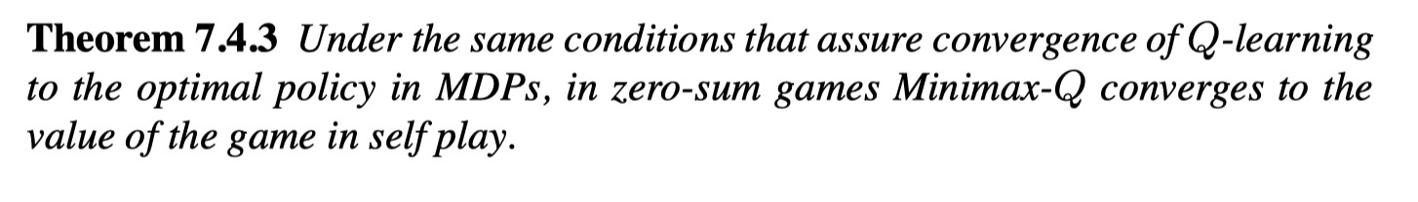
Convergence and Limitations
MiniMax-Q converges but only in 2-player zero-sum Games
Friend-or-Foe-Q extends this to general sum n-player games, but the other players must be known to the agent as either “friend” (playing for coordinated equilibrium) or “foe” (playing for adversarial equilibrium), so in a sense this is a 2-player game again, just in teams.
More general algorithms exist but they are only guaranteed to converge only under very strict conditions
No known solution for general-sum, n-player games
FIT3155-S2-2024
Week-9
Notes:
Convergence and Limitations of MinMax-Q:
MinMax-Q Convergence: MinMax-Q, which is an extension of Q-learning for 2-player zero-sum games, converges to the value of the game under the same conditions that assure convergence in traditional Q-learning for Markov Decision Processes (MDPs). These conditions typically include the exploration of all state-action pairs infinitely often and a learning rate that diminishes over time.
Limitation to 2-Player Zero-Sum Games: The MinMax-Q algorithm is designed specifically for two-player zero-sum games where one player's gain is exactly the other player's loss. It converges in this context because both players are optimizing their policies based on worst-case scenarios (adversarial play). However, in games that are not zero-sum or involve more than two players, the algorithm does not guarantee convergence.
Extension to General Sum, n-Player Games:
Friend-or-Foe-Q: To handle general-sum games (games where outcomes aren't strictly zero-sum), Friend-or-Foe-Q was introduced. This algorithm extends MinMax-Q to handle n-player games by classifying other players as either:
Friends: These players are assumed to be working towards a cooperative or coordinated equilibrium, where they optimize joint strategies.
Foes: These players are assumed to be adversaries, where the goal is to minimize the worst-case outcome, similar to zero-sum game dynamics.
Despite this extension, the method still reduces the problem to a form of 2-player dynamic where groups of "friends" work together against "foes," effectively simplifying it to team-based dynamics.
Limitations of Friend-or-Foe-Q: Friend-or-Foe-Q requires prior knowledge of whether each player is a friend or a foe. This assumption limits its practical application because, in real-world environments, such clear distinctions are rarely known in advance. It also limits the scope of the algorithm to team-based adversarial games, rather than general n-player games with complex, independent strategies.
More General Algorithms:
General Algorithms for Multi-Agent RL: More general algorithms exist for handling multi-agent reinforcement learning in environments with more than two players or non-zero-sum payoffs. However, these algorithms typically have limited convergence guarantees. They often converge only under very strict conditions, such as well-defined equilibria (e.g., Nash equilibria) or highly structured game environments.
No Known Solution for General-Sum, n-Player Games: For general-sum n-player games, where players have independent strategies and payoffs aren't strictly zero-sum, no widely accepted reinforcement learning algorithm exists that can guarantee convergence. The inherent complexity and unpredictability of strategies in such games make it extremely difficult to achieve stable learning dynamics that apply universally.
In summary, MinMax-Q is powerful for 2-player zero-sum games, and Friend-or-Foe-Q offers an extension for team-based games, but the challenge of converging in general-sum, n-player environments remains largely unsolved in the field of multi-agent reinforcement learning.

Slide 14
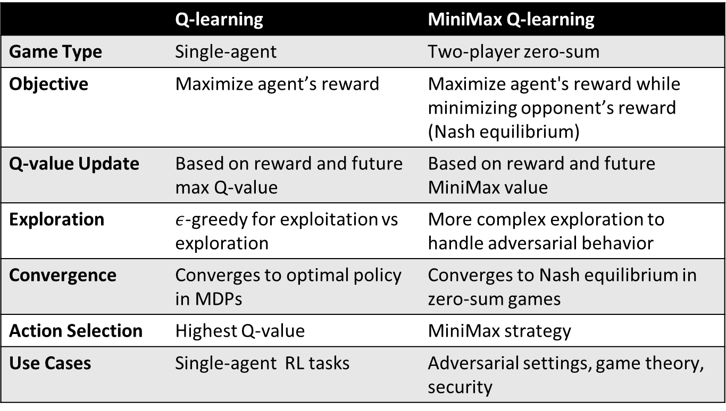
Q- vs MiniMax-Q Learning
 | Q-learning | MiniMax Q-learning
Game Type | Single-agent | Two-player zero-sum
Objective | Maximize agent’s reward | Maximize agent's reward while minimizing opponent’s reward (Nash equilibrium)
Q-value Update | Based on reward and future max Q-value | Based on reward and future MiniMax value
Exploration | $ε$-greedy for exploitation vs exploration | More complex exploration to handle adversarial behavior
Convergence | Converges to optimal policy in MDPs | Converges to Nash equilibrium in zero-sum games
Action Selection | Highest Q-value | MiniMax strategy
Use Cases | Single-agent RL tasks | Adversarial settings, game theory, security
FIT3155-S2-2024
Week-9

